Slide 1

CS-401
Computer Architecture & Assembly Language Programming
Lecture-22
Software Interrupts

Slide 2

Lets revise the last lecture

Slide 3
Concept and detail of interrupts

Slide 4

NMI (Non Maskable Interrupt)

Slide 5
Interrupts allow and disallow

Slide 6
Debug interrupt

Slide 7
Overflow interrupt

Slide 8
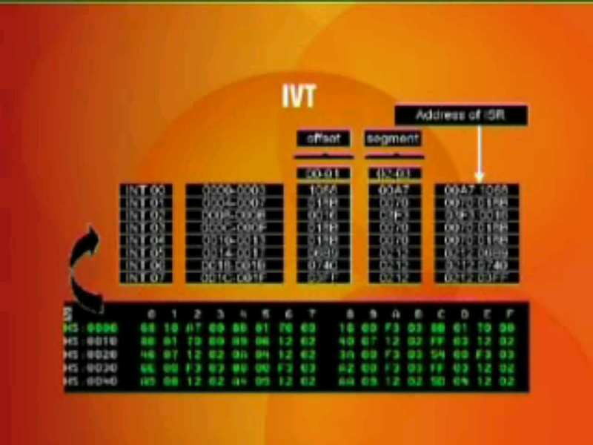
IVT

